Slide 1

Tahapan Pengembangan Proyek Sistem Informasi
Otniel y. viktorisa

Slide 2
Tahapan Pengembangan
Planning
Requirements analysis/gathering
Design
Implementation
Testing
Production (Go-live)
Maintenance & support

Slide 3
Planning
Pembentukkan tim pengembang
Penentuan lingkup pengerjaan (scope of work)
Pemilihan metode, strategi, dan teknologi dalam pengembangan

Slide 4
Planning > Pembentukan tim pengembang
Project manager
Technical lead
Business analyst (functional)
Developer
UI/UX Designer
QA (tester)
Technical writer
Infrastructure engineer

Slide 5
Planning > Penentuan lingkup pengerjaan (scope of work)
New development/enhance/maintenance
Modules and features
Out of scope definition

Slide 6
Planning > Pemilihan metode, strategi, dan teknologi dalam pengembangan
Waterfall/scrum/kanban
Programming language & framework
Database
etc

Slide 7
Requirements analysis/gathering
Who : client (users, business analyst), development team (business analyst, technical lead)
What : functional specification document
How : in-depth discussion

Slide 8
Requirements analysis/gathering > Functional specification document
System description
List of features/modules
List of actors/users
Use case diagram
User flow (happy path, negative flow)
UI Mockup

Slide 9
Design
UI & UX design
Database design
Architecture design
Infrastructure design

Slide 10
Implementation
Coding
Coding
Coding
Unit test

Slide 11
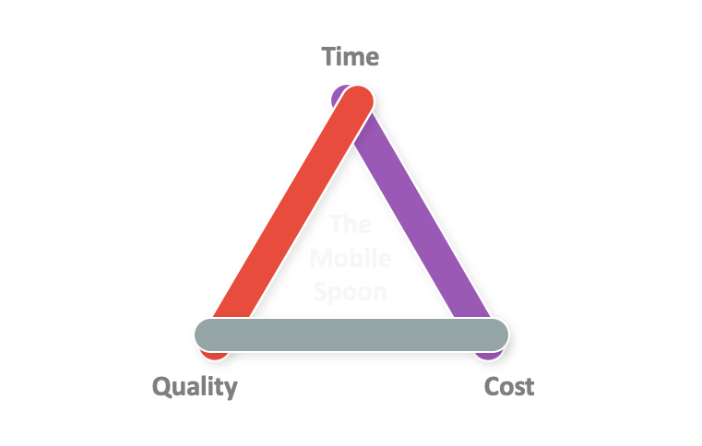
Implementation

Slide 12
Testing
Integration test
Regression test
Penetration test
Stress test
User acceptance test

Slide 13
Production (go-live)
Deployment to production environment
Data migration
User training

Slide 14
Maintenance & support
Bug fixing
Issue support

